Slide 1

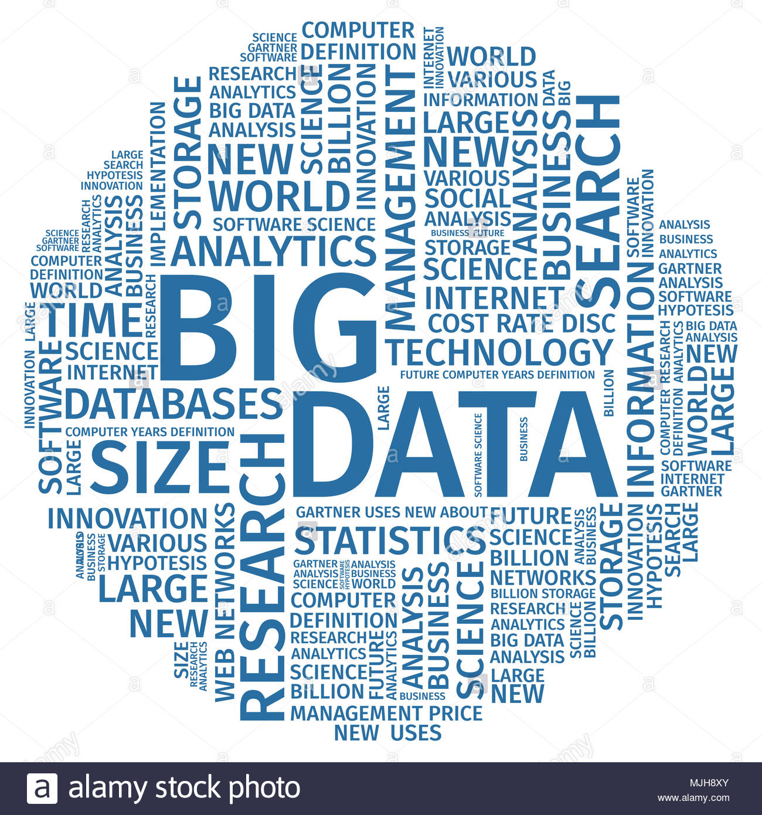
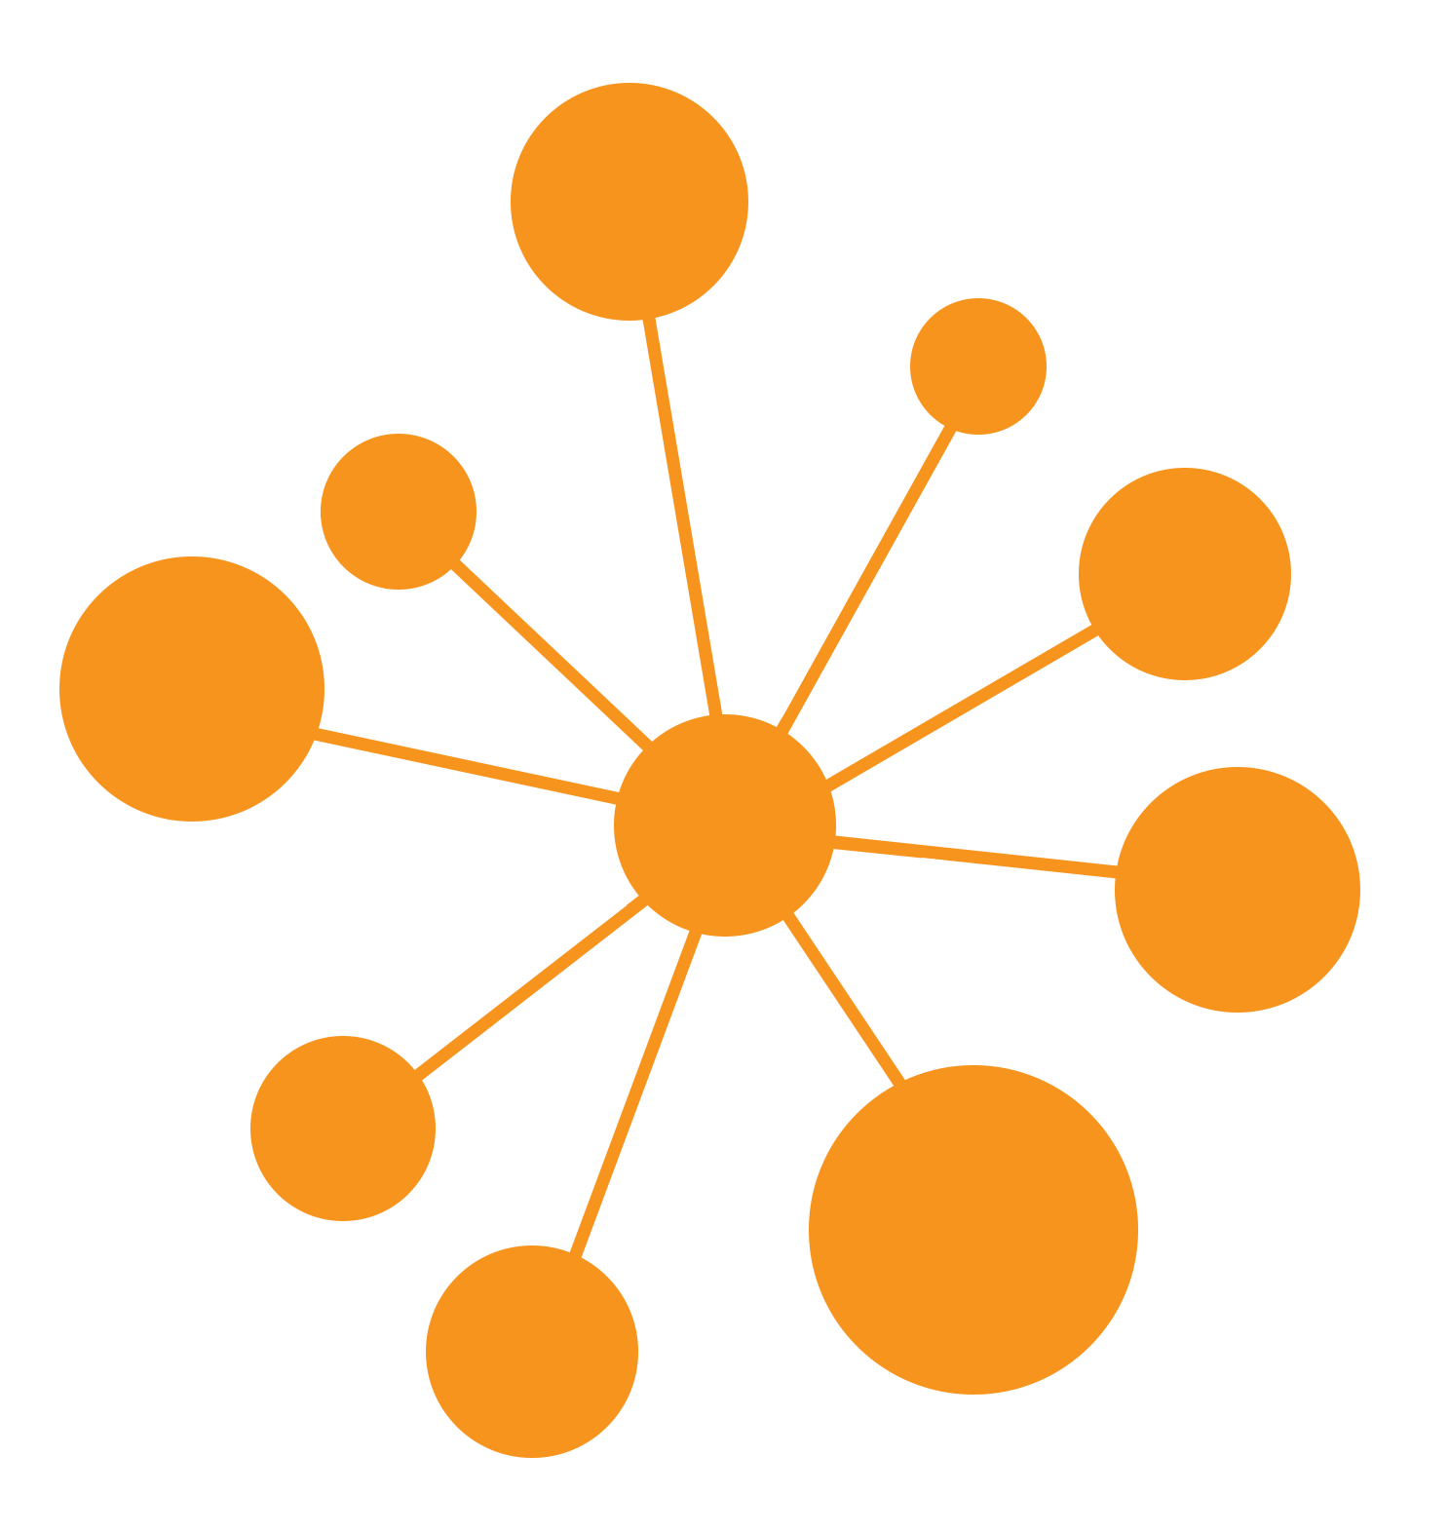
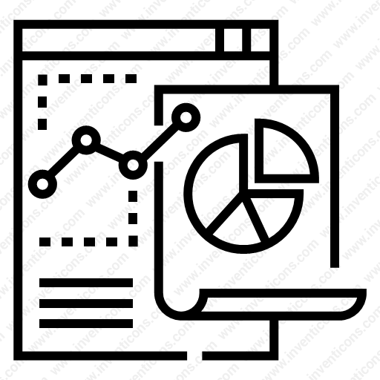

데이터과학부 Data Science 동아리
Data Network Analysis
What is DNA?
Three directions of DNA
1. No relation of age, sex, academic background
2. Research on various domains
3. Sharing information from people in the business or research
How to Network?
DNA means that each person should be able to find their own color
and pass on their information to the next generation.
Every month or quarter, we plan to achieve one project we want
and have a place to share
What will be analyzed?
We are currently studying various fields
Digital Health Care Explainable AI Recommendation System,
Social Research Natural Language Process
DNA official website : https://bit.ly/2kyBcmZ

